Slide 1
7-Dimensional Telescope
Exploring the Universe in the Seven Aspects

Slide 2
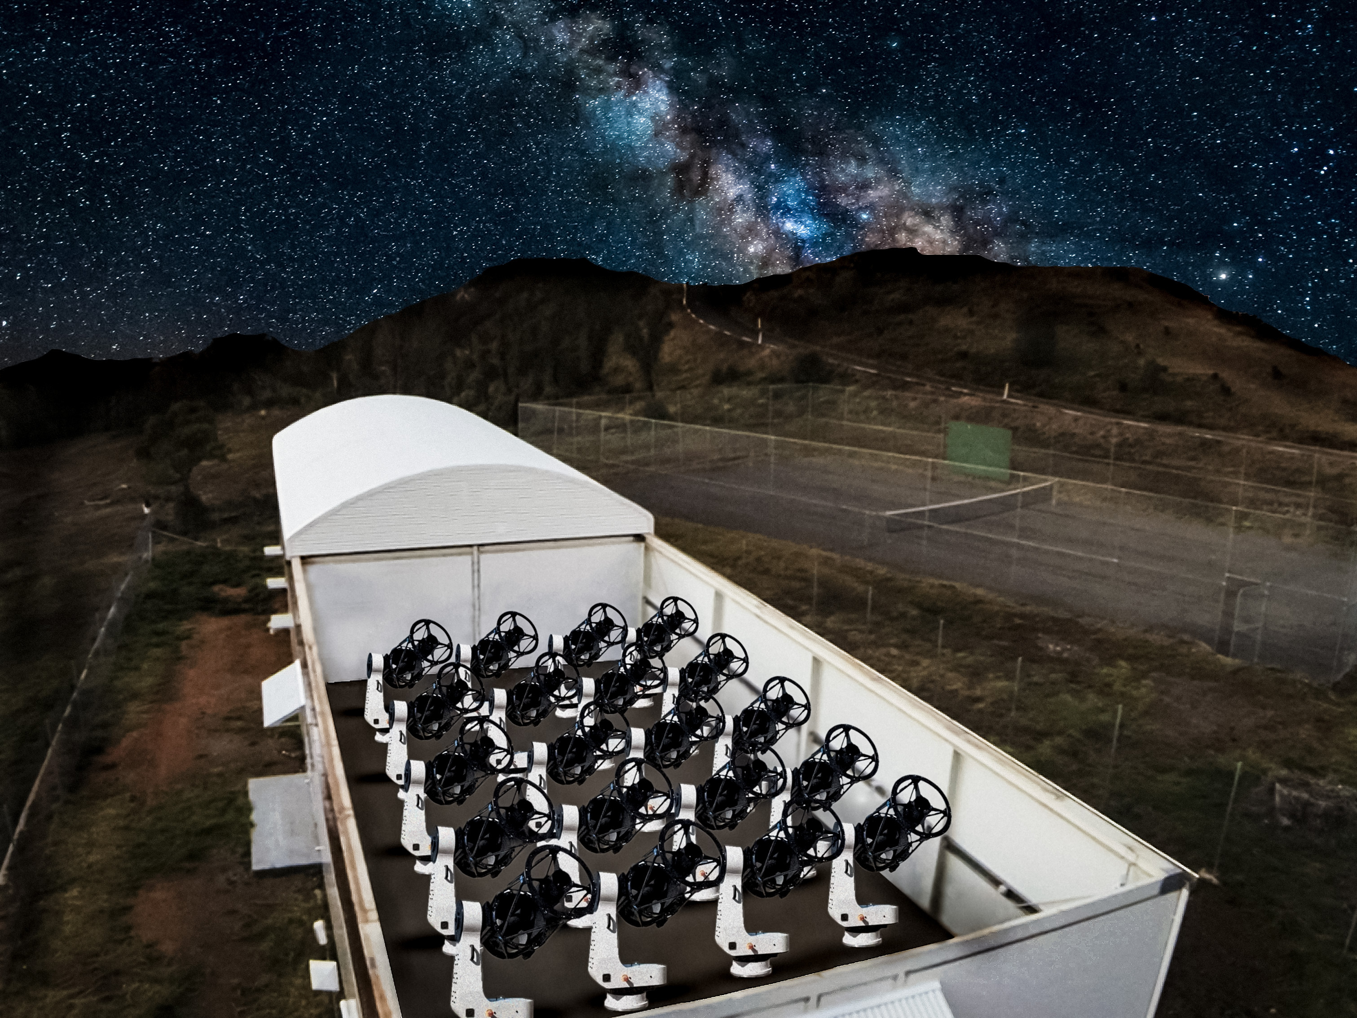
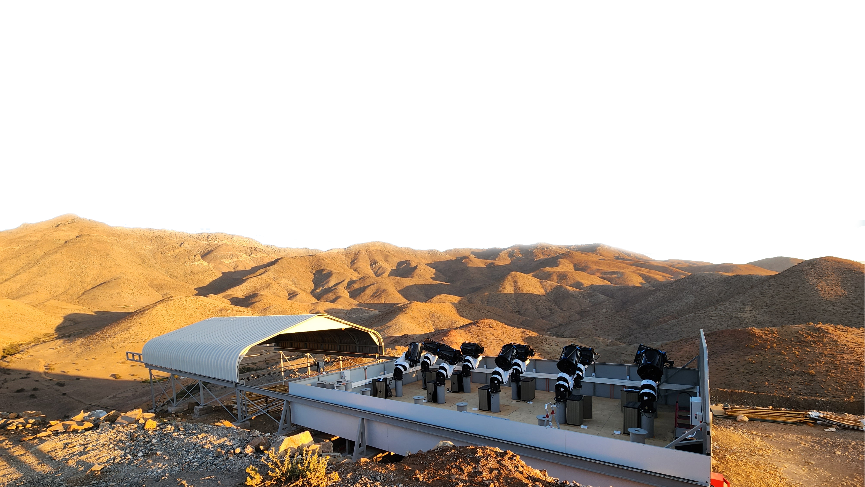

Slide 3
Latitude
Longitude
Distance
Radial Velocity
Brightness
Wavelength
Time

Slide 4

7-Dimensional
Sky Survey

